Slide 1

Programming your Ev3 in 10 easy lessons
By: Droids Robotics
www.ev3lessons.com

Slide 2
Section 1: EV3 BASICS

Slide 3
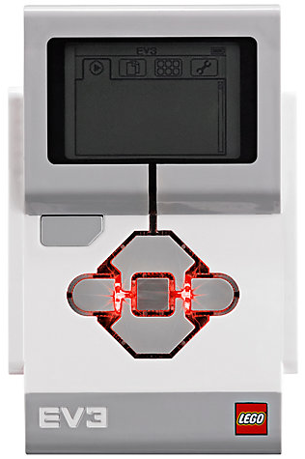
The “Brick” Buttons
1 = Back Undo Stop Program Shut Down EV3
2 = Center Button Select options Run Program
3 = L, R, Up, Down Navigate menus
1
3
3
2
3
3

Slide 4
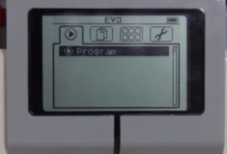
The “Brick” Screen
Tabs on Screen
Run Recent Find programs you ran recently
2. File Navigation Find all programs by project
3. Brick Apps Port views
4. Settings Bluetooth, Wifi, Volume
1
2
3
4

Slide 5
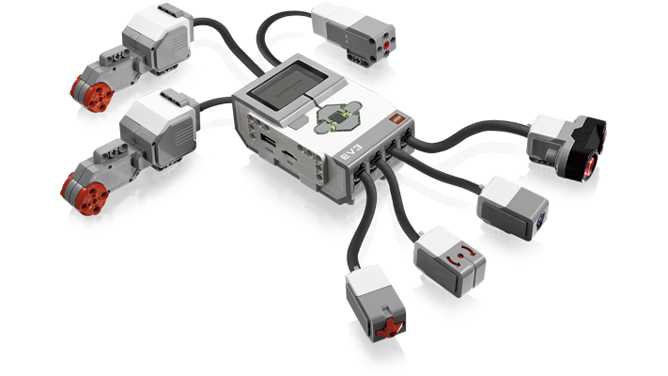
Ports, Sensors, motors
Ports A, B, C, D = Motors
Default setup assumes Right Motor in C, Left Motor in B
B
Default setup
C
Ports 1, 2, 3, 4 = Sensors

Slide 6
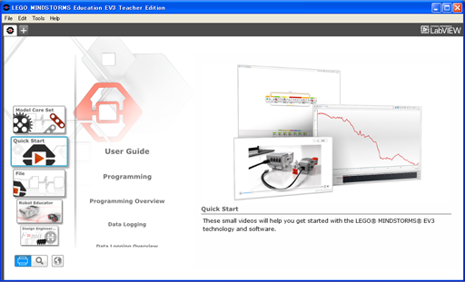
EV3 Software
Open Saved Project
Open New Project

Slide 7
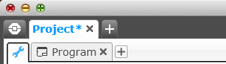
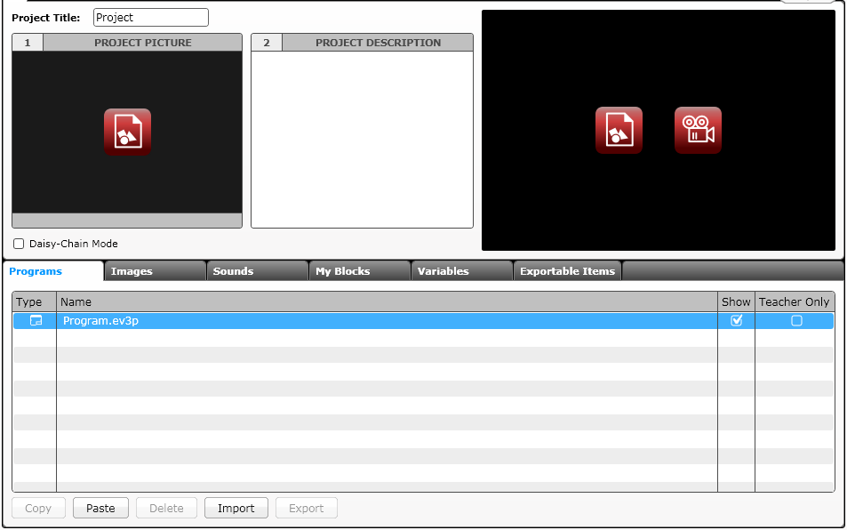
EV3 Software: Starting A new program
Create a Project
Opened Projects
Opened Programs
Create a Program
Project Properties
List of programs

Slide 8
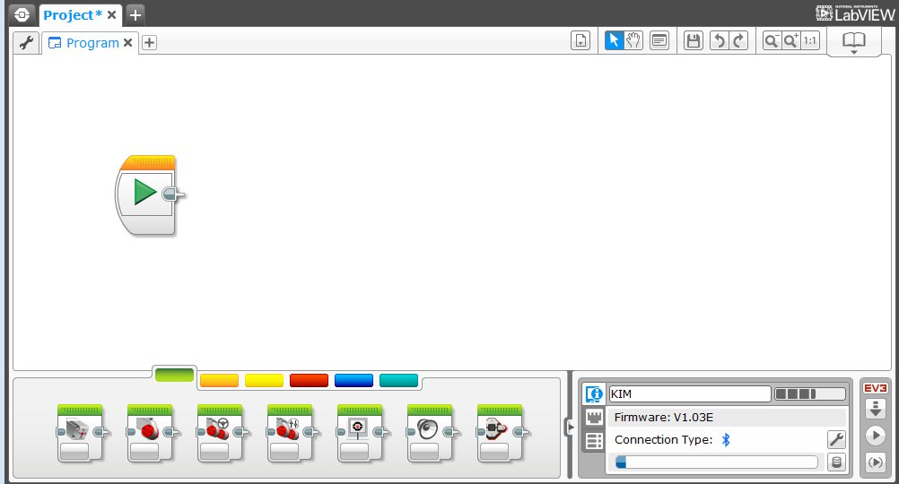
EV3 Software: Programming screen
Programming Area or Canvas
Programming Blocks in
6 Colored Tabs
Brick Status & Downloading

Slide 9
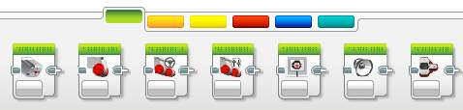
EV3 Blocks: Colored Tabs
ACTION BLOCKS
Move, Large & Medium Motor, Display…
FLOW BLOCKS
Start, Wait, Loop, Switch, Loop Interrupt
SENSOR BLOCKS
Brick Buttons, Gyro, Color, Ultrasonic
DATA OPERATIONS
Variables, Array, Logic, Math, Compare…
ADVANCED BLOCKS
Data Logging, Unregulated Motor…
MY BLOCKS
Custom Blocks you create

Slide 10
Section 2: MOVING STRAIGHT

Slide 11

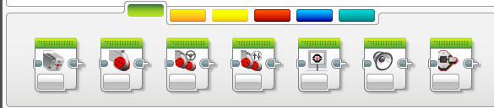
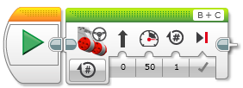
CHALLENGE: Move Straight
STEP 1: Green Block Tab, Click and hold Move Steering and drag to programming area
STEP 2: Drop next to the Start Block (green arrow)

Slide 12
Move STEERING Block
B
C
Mode of operation
Brake/Coast
Steering: Straight or turn
Power/Speed
Duration/Distance

Slide 13
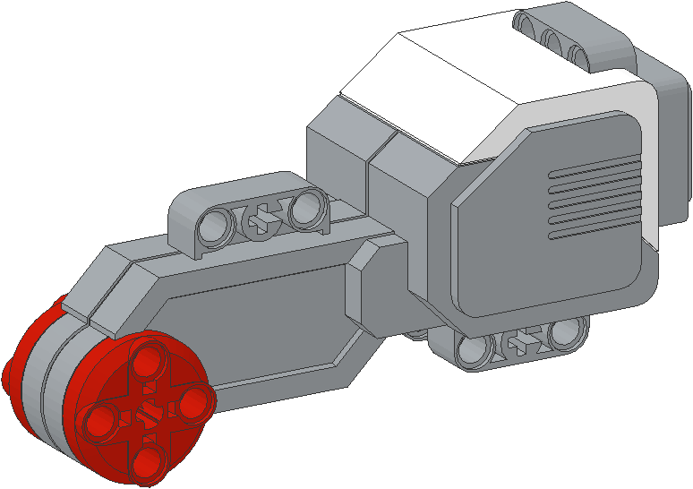
NEGATIVE & POSITIVE POWER: BACKWARD & FORWARD
Negative Power = Backwards
Positive Power = Forward

Slide 14
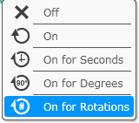
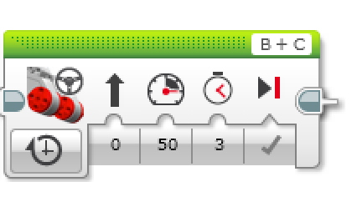
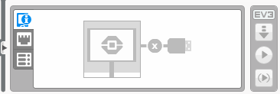
CHALLENGE: Move Straight (3 SECONDS)
STEP 1: Green Block Tab, Click and hold Move Steering and drag to programming area
STEP 2: Drop next to the Start Block (green arrow)
STEP 3: Select Options. Move “3 Seconds”
STEP 4: Connect USB cable to EV3 and Laptop.
STEP 5: Download to EV3

Slide 15
Move Straight: Seconds vs. degrees vs. rotations
FINISH
CHALLENGE: Move your robot forward from the start line to the finish line (1) and back to the start (2).
Try: Select SECONDS, DEGREES or ROTATIONS
Try: Different speeds
What are some advantages or disadvantages of using each one?
Did you have to do a lot of guess and check to reach the line?
1
2
B
START
C

Slide 16
MOVE STRAIGHT CHALLENGE – PART 1 SUMMARY
TEAMS | SECONDS | DEGREES | ROTATIONS
Team 1
Team 2
Team 3
Team 4

Slide 17
MOVE STRAIGHT discussion
Teams | Did you guess and check a lot? | Did changing the speed matter? | What was more accurate? Seconds? Degrees? | Do you think wheel size will matter? | Do you think battery level matters?
Team 1
Team 2
Team 3
Team 4

Slide 18
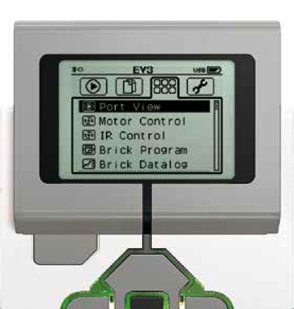
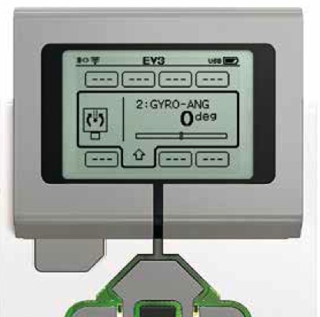
Moving Straight more accurately: Use Port View
Try “port view” on brick (on Brick Apps tab)
Move your robot with your hand from your start line to your end line
Read how many degrees your robot moved
Use this number in the Move Steering Block to move the correct distance.

Slide 19
SECTION 3: TURNING

Slide 20
PIVOT Vs. SPIN Turns
180 Degree Pivot Turn
Notice where the robot ends in both pictures after a 180 degree turn.
In the Spin Turn, the robot moves a lot less and that makes Spin Turns are great for tight positions. Spin turns tend to be a bit faster but also a little less accurate.
So when you need to make turns on the FLL board, you should decide which turn is best for you!
B
End Position
Motor
B Moves
C
B
Start Position
C
180 Degree Spin Turn
Start Position
End Position
B
B
Motors
B and C Move
C
C

Slide 21
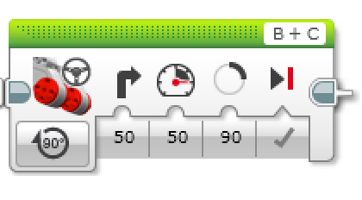
How to Make Pivot and Spin turns
Steering Value
50 | -50 | 100 | -100
Pivot Turn Right | Pivot Turn Left | Spin Turn Right | Spin Turn Left
B
B
B
B
C
C
C
C
Change Steering value here

Slide 22
MAKING A Pivot turn for 90 DEGREES
?
B
B
C
C
Program your robot to turn 90 degrees....Does the robot actually turn 90 degrees if you just pick 90 degrees for distance?

Slide 23
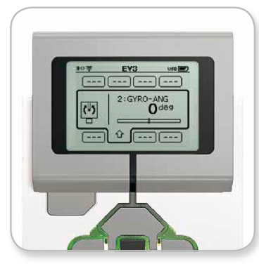
how do you make the robot turn 90 degrees?
Ans. Try using the port view again to measure the turn and then input the correct number of degrees.

Slide 24
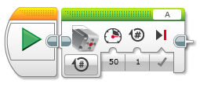
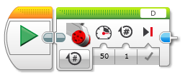
TURNING An Attachment ARM, not just the wheels
Attach a medium motor to Port A or a large motor to Port D as needed.
Move Steering vs. Motor Block
For moving your wheels you should use a Move Steering Block that syncs both wheel motors.
For moving your attachment your arm, you use either a Medium Motor Block or a Large Motor Block because you don’t need to sync your motors.
Medium Motor Block
Large Motor Block

Slide 25


Motor “On” and “Wait” Blocks
Leaving the motor “on” and “off”
Why use the “on” instead of “degrees”?
May want the program to do other tasks while moving
“Wait” block in Flow Tab
Wait for seconds
WAIT!

Slide 26
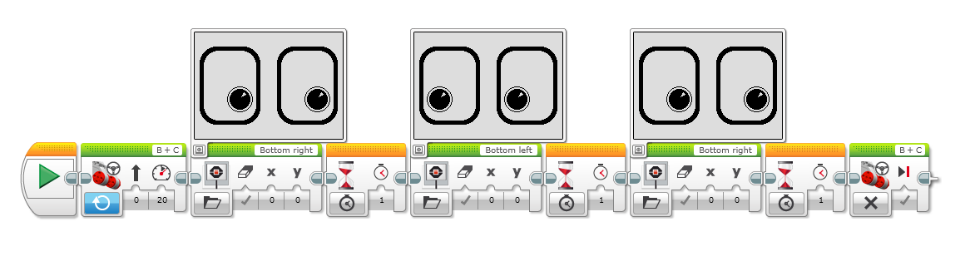
Something fun: Display Block
Use the Display Block to display information and pictures on the screen
You can control the location and size of text
You can use this same block to display sensor readings and instructions.
Challenge: Can you display eyes on the screen while moving? Alternate eyeballs that look left and right.
Use the Display Block, Motor On and Wait Block

Slide 27
CHALLENGE Solution
Motor On
Display Block
Wait Block
Motor Off

Slide 28
SECTION 4: TOUCH SENSOR

Slide 29
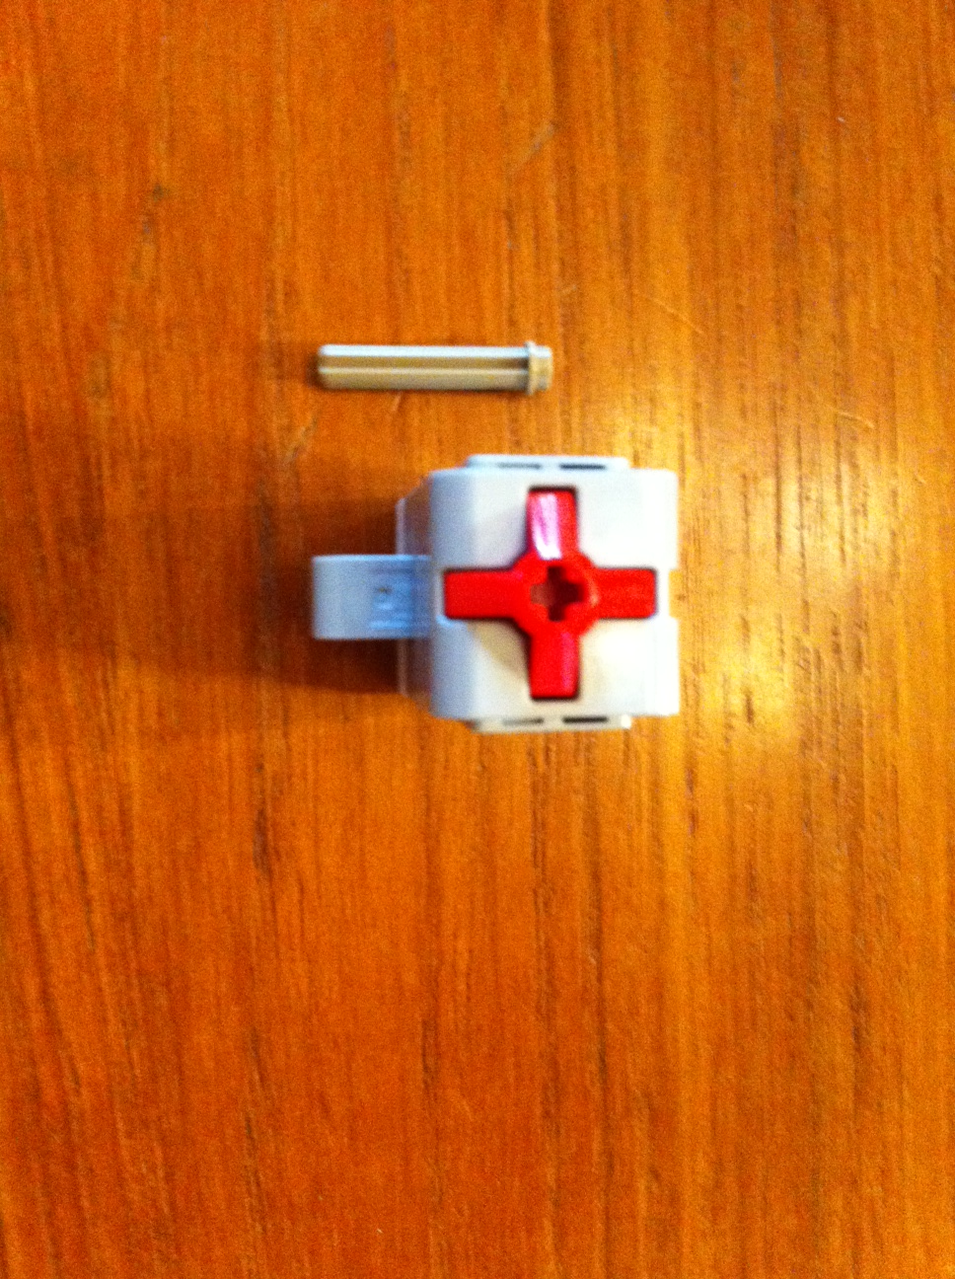
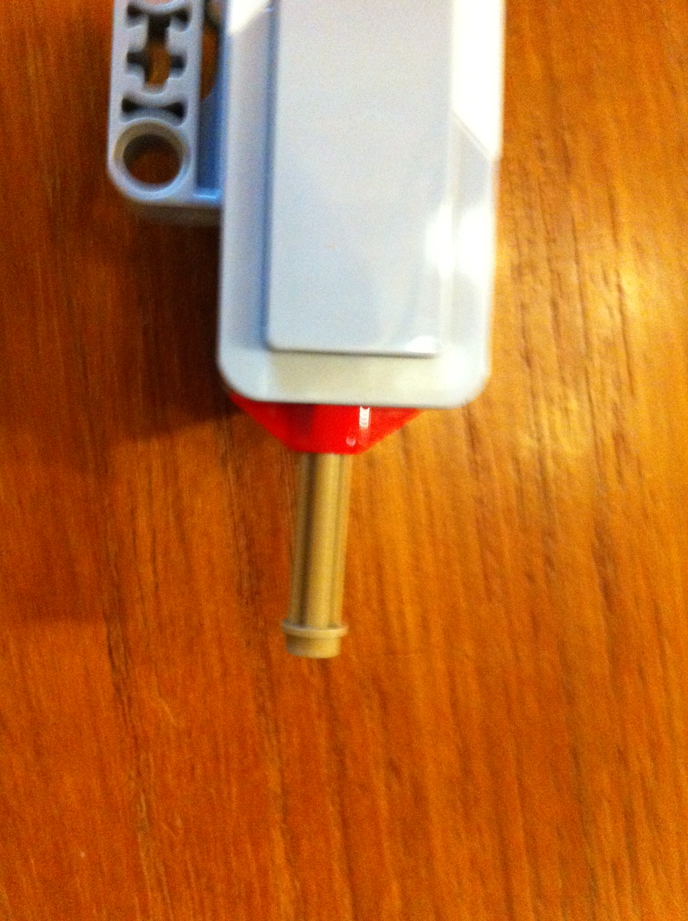
Modification to your Robot Build
If you built the robot that we recommended, you will have to make a minor modification to the design so that the touch sensor is more accessible.

Slide 30

SENSOR TAB vs. FLOW TAB (READING VS Wait for Sensor)
Compare sensor block to wait block
When should we use one or the other
Sensor Tab Sensor Blocks = Reading and Comparing Sensor Values
Flow Tab Wait For Block = Wait until a sensor reading
In this tutorial, we will use the
Wait For Block

Slide 31
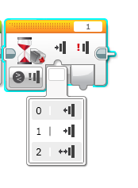
Using The Touch Sensor
Challenge 1: Program your robot to move straight until you touch the sensor with your hand.
Challenge 2: Program your robot to move until it hits the edge of the FLL table past the dog and cat missions. Then back up to the black line and turn right 90 degrees.
0 = released
1 = pressed
2 = bumped
Hint: You will combine everything you have learnt so far: Move Steering + Turning + Wait Block

Slide 32
SECTION 5: Color SENSOR

Slide 33
Using the color sensor
One of the ways for the robot to know its location is to take advantage of the markings on the field mat.
Every year, the Robot Game’s mat has lines or dark markings that can be detected by the Color Sensor.
Common uses:
Move until a line
Follow a line
Introduce color sensor
Modes:
Color, Reflected Light, Ambient Light
We will use the COLOR mode in this tutorial.

Slide 34
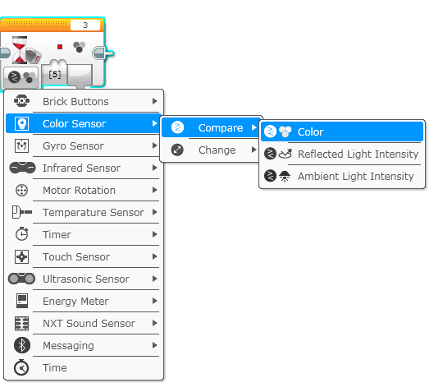
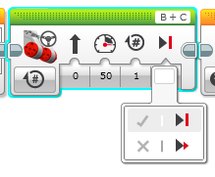
Using Color Sensor in color mode
CHALLENGE: Make the robot move up to the green line using the color sensor?
Step 1: Use Wait For Color
Step 2: Use the color sensor in COLOR MODE
Step 3: Coast or Break?
Tip: Coast will make the motors keep moving. Break makes the motors stop immediately. Which do you use to stop EXACTLY on the green line?

Slide 35
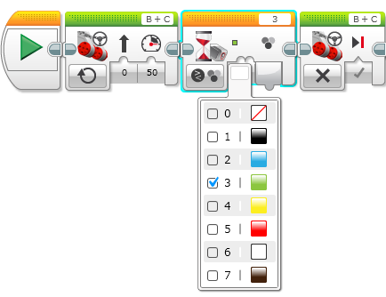
Color Sensor Challenge Solution
FINISH
Move Steering
Set to “ON”
Move Steering
Set to “OFF” with BREAK
START
Wait until Color is Green (#3)

Slide 36
SECTION 6: REPEATING ACTIONS

Slide 37
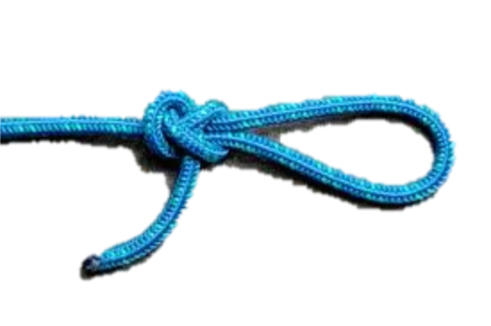
Repeating an Action
How can we move around a box using the commands we already know?
(move + turn) + (move + turn) + (move + turn) …
Loops make repeating a task multiple times easy
Is there an easier way?
Hint:

Slide 38
Loops
Loops make repeating a task multiple times easy
KEEP GOING….Forever, for a Count, Until touch (or something else)
Challenge: Write a program to go around the box until touched

Slide 39
WHAT WE KNOW SO far
1) What is each Block called?
2) Where do you find it?
3) What does it do?
4) When do we use it?
A
B
D
C
E

Slide 40
SECTION 7: SWITCHING BETWEEN ACTIONS

Slide 41
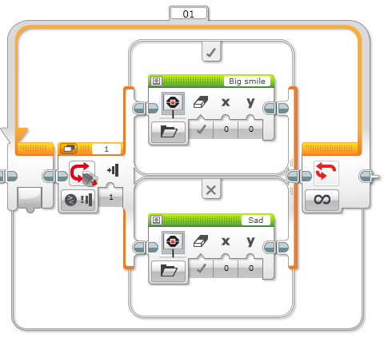

Switch Blocks
Switch block
Asking the robot a question and doing something different based on the answer
Example: Is the robot’s touch sensor pressed? Or not?
Does the robot see a line? Or not?
Basically a YES/NO QUESTION
Switch blocks are found in the orange/flow tab

Slide 42
Switch Block CHALLENGE 1
Challenge: Write a program that changes based on if the touch sensor is pressed or not pressed.
If pressed, your EV3 is happy! Display a smiley face. If not pressed, the EV3 is sad! Display a sad face.
Hint: You will need to use the display block and loops from yesterday and switch blocks from today!

Slide 43
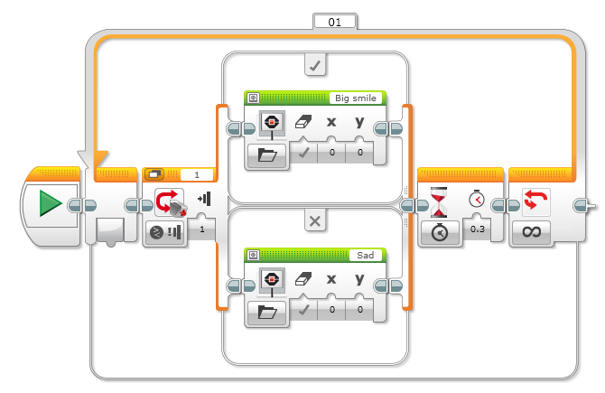
Challenge 1 SOLUTION
Display Block
Touch Sensor
Selected
Wait Block
Loop
Display Block

Slide 44
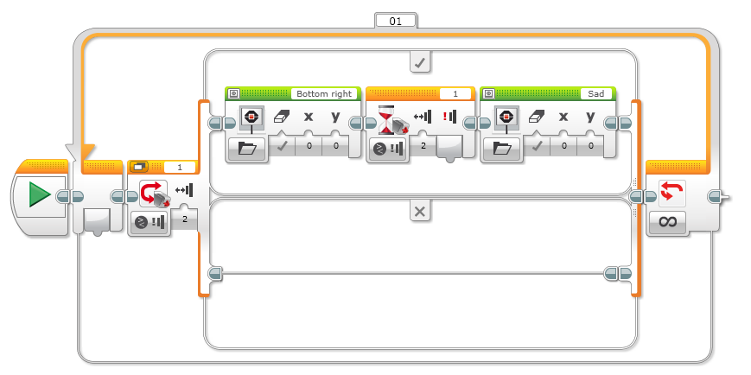
Switch Block Challenge 2
Can you write a program that displays a smiley if you touch it once and a sad face if you touch it a second time and toggles back and forth.

Slide 45
SECTION 8: ULTRASONIC

Slide 46
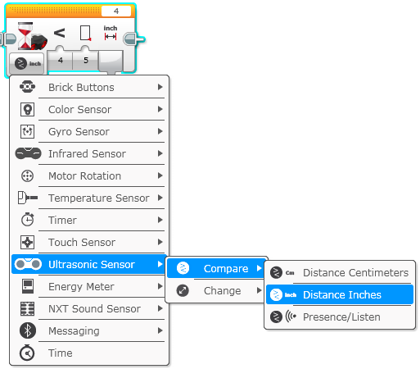
Move for ultrasonic
Challenge: Make the robot move until it is 5 inches away from the wall.
Step 1: Make a new program
Step 2: Set move to “on”
Step 3: Set wait block to use the Ultrasonic
Step 4: Set move block to “off”

Slide 47
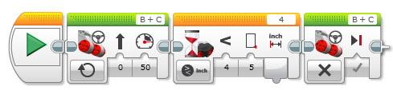
Challenge 1 solution:

Slide 48
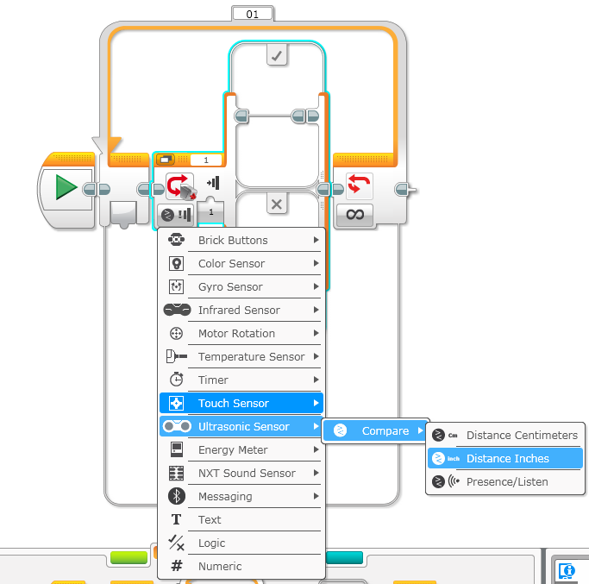
Challenge 2: Dog Follower
Challenge: If the robot is closer than 5 inches away from your hand move backward, otherwise move forward.
Step 1: Drag a loop from the orange tab
Step 2: Drag switch inside loop
Step 3: Set switch to Ultrasonic
Step 4: Set move steering block to ON and place in TRUE
Step 4: Set move steering block to OFF and place in FALSE

Slide 49
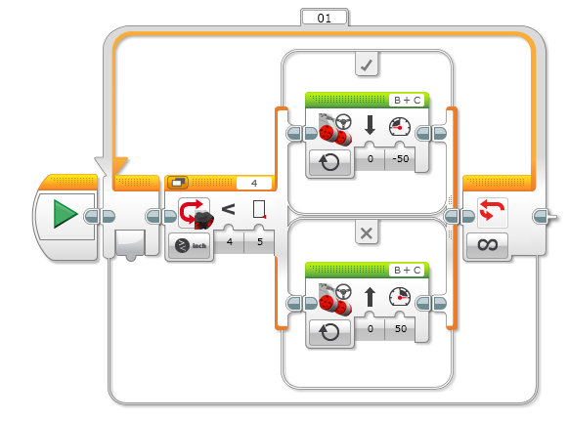
Challenge 2 solution:

Slide 50
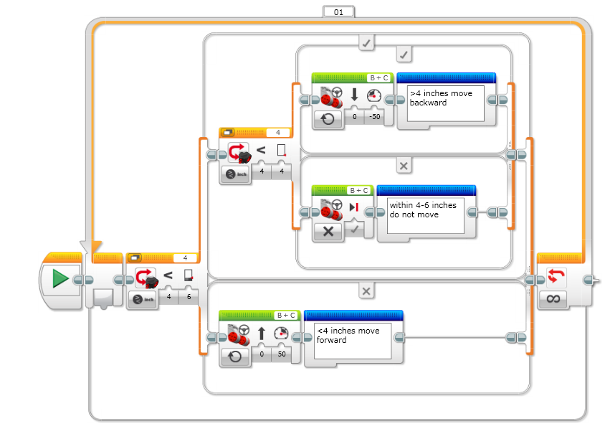
Better Dog follower:

Slide 51
REVIEW
Turns: Spin and Pivot
Port View: Sensor readings on the brick
B
Spin (used in tight spaces)
C
B
Pivot
C
Wait Block:
Wait for a sensor reading (touch, ultrasonic, color) or time
Move until line, Move until touch

Slide 52
SECTION 9: Line follower

Slide 53

FOLLOW THE MIDDLE?
Humans want to follow the line in the middle.
Let’s have the robot do the same thing using the Color Sensor
What type of questions can we ask using this sensor
Are you on line or not?

Slide 54
If we are on black, keep going straight
If we are on white, turn left to get back to the line
Seems to work fine here…

Slide 55
If we are on black, keep going straight
If we are on white, turn left to get back to the line
OH NO… my robot is running away….
When the robot leaves the left side of the line, the program no longer works!

Slide 56
Line Following: ROBOT STYLE
Why could the Human follow the middle?:
They can see ahead.
They can see the whole line and its surroundings
They see both sides and which side they left
Why can’t the Robot do the same thing?:
Can’t tell right or left side of the line
How do we make sure the robot always veers off on the SAME SIDE of the line?
Instead of the middle, could the robot follow the “edge”?
So now the robot will fall off only the same side.
We will now show you how this works!

Slide 57
ROBOT LINE FOLLOWING Happens on the edges
Left side line following
Right side line following
If on black, turn left.
If on white turn right.
If on black, turn right.
If on white turn left.
The robot has to choose which way to turn when the color sensor sees a different color.
The answer depends on what side of the line you are following!

Slide 58
starting the roboT on the correct side
✗
✔
✔

Slide 59
Line Follower challenge
Step 1: Write a program that follows the RIGHT edge of a line.
Hints: If your sensor sees black, turn left. If your sensor sees white, turn right. Use loops and switches!
Step 2: Try it out on different lines.
Did your line follower work the same on straight and curved lines?
Step 3: If not, instead of turn Steering = 50, try smaller values.
Is it better on the curved lines now?
B
B
C
C

Slide 60
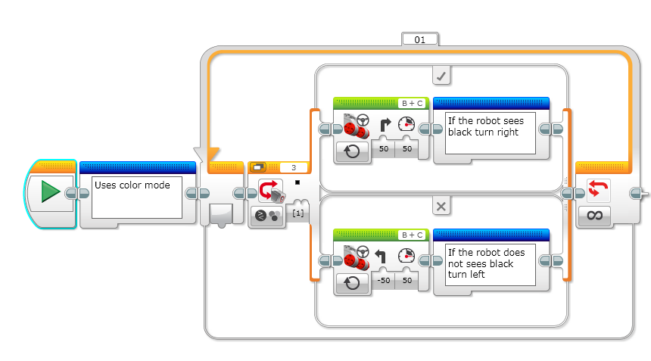

LINE FOLLOWING CHALLENGE SOLUTION
New Feature: Comment
Block in Blue Advanced Tab
Does this program follow the Right or Left side of a line?
Notes:
Right side

Slide 61
LINE FOLLOWING CHALLENGE SOLUTION
New Feature: Comment
Block in Blue Advanced Tab
How do we make this stop?
Notes:
Right side

Slide 62
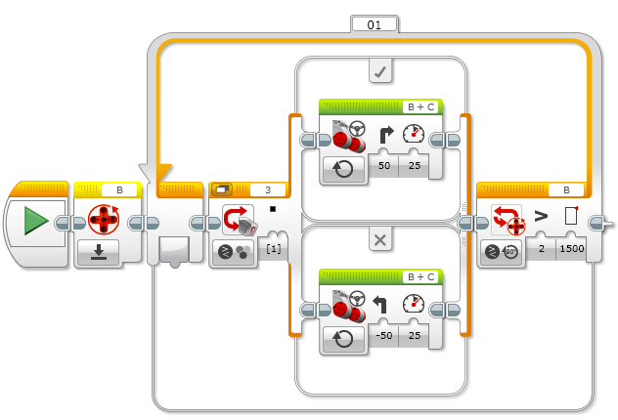
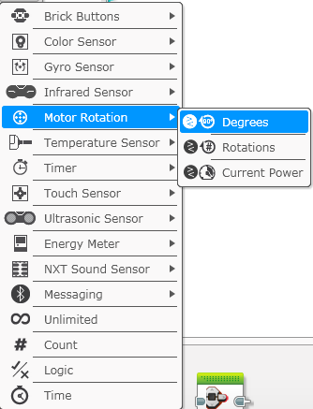
Line following for a Sensor or distance

Slide 63
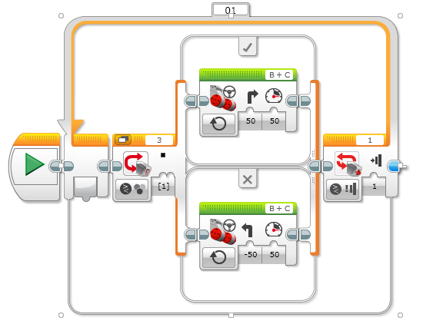
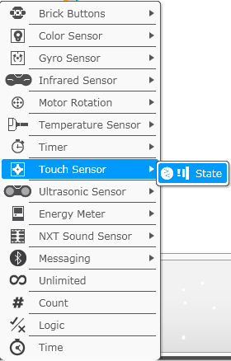
Line following for a Sensor or distance

Slide 64
SECTION 10: FINAL CHALLENGE

Slide 65
FINAL MAZE CHALLENGE
Combine everything you know to navigate a maze like this.
END
Touch this,
back up
Do not knock obstacles
Safe Zone You pick up here
START
Do not Touch this

Slide 66

CREDITS
This tutorial was created by Sanjay Seshan and Arvind Seshan from FLL Team Not the Droids You Are Looking For (Droids Robotics)
We have additional material for more advanced lessons available on request.
Useful tools for FLL teams and robot programmers are available at www.ev3lessons.com
The material is made available to you free of charge. However, we would greatly appreciate a letter indicating that you are using the materials and what you think of them.
Feedback and suggestions are encouraged.
Email: team@droidsrobotics.org

